Slide 1
UNIT-III
Multiple logistic regression
Forward method
Backward method

Slide 2
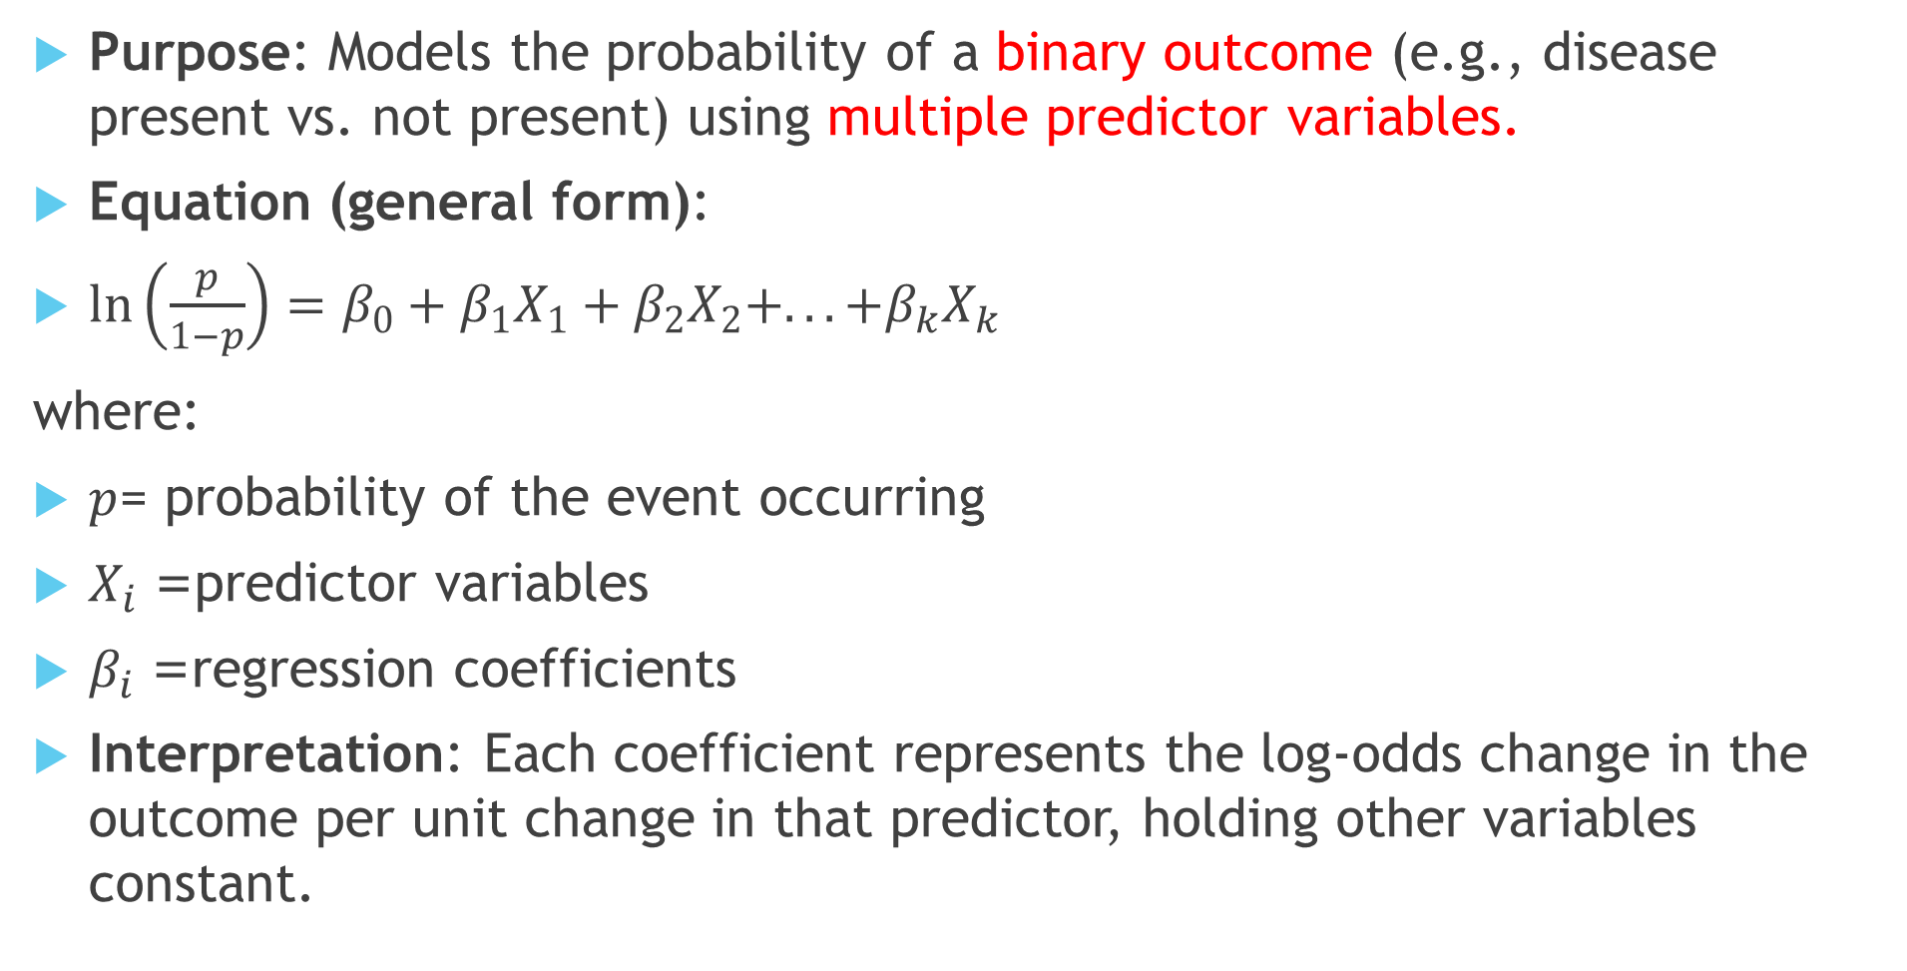
Multiple Logistic Regression (MLR)
Purpose: Models the probability of a binary outcome (e.g., disease present vs. not present) using multiple predictor variables.
Equation (general form):
$\ln\left(\frac{p}{1−p}\right)=β_{0}+β_{1}X_{1}+β_{2}X_{2}+...+β_{k}X_{k}$
where:
$p$= probability of the event occurring
$X_{i}$= predictor variables
$β_{i}$= regression coefficients
Interpretation: Each coefficient represents the log-odds change in the outcome per unit change in that predictor, holding other variables constant.

Slide 3
1. Forward Selection
When you have many predictors, you usually don’t include them all at once—some may be irrelevant or redundant. That’s where Forward and Backward Selection come in.
Process: Start with no predictors → add them one at a time.
Steps:
  Begin with only the intercept.
  Add the predictor that improves the model fit most (lowest p-value, largest likelihood ratio test improvement, or best AIC/BIC score).
  Continue adding predictors one by one, at each step picking the most significant one.
  Stop when no additional variable significantly improves the model.
Advantage: Efficient when you have many predictors.
Disadvantage: May miss predictors that only become significant in combination with others.

Slide 4
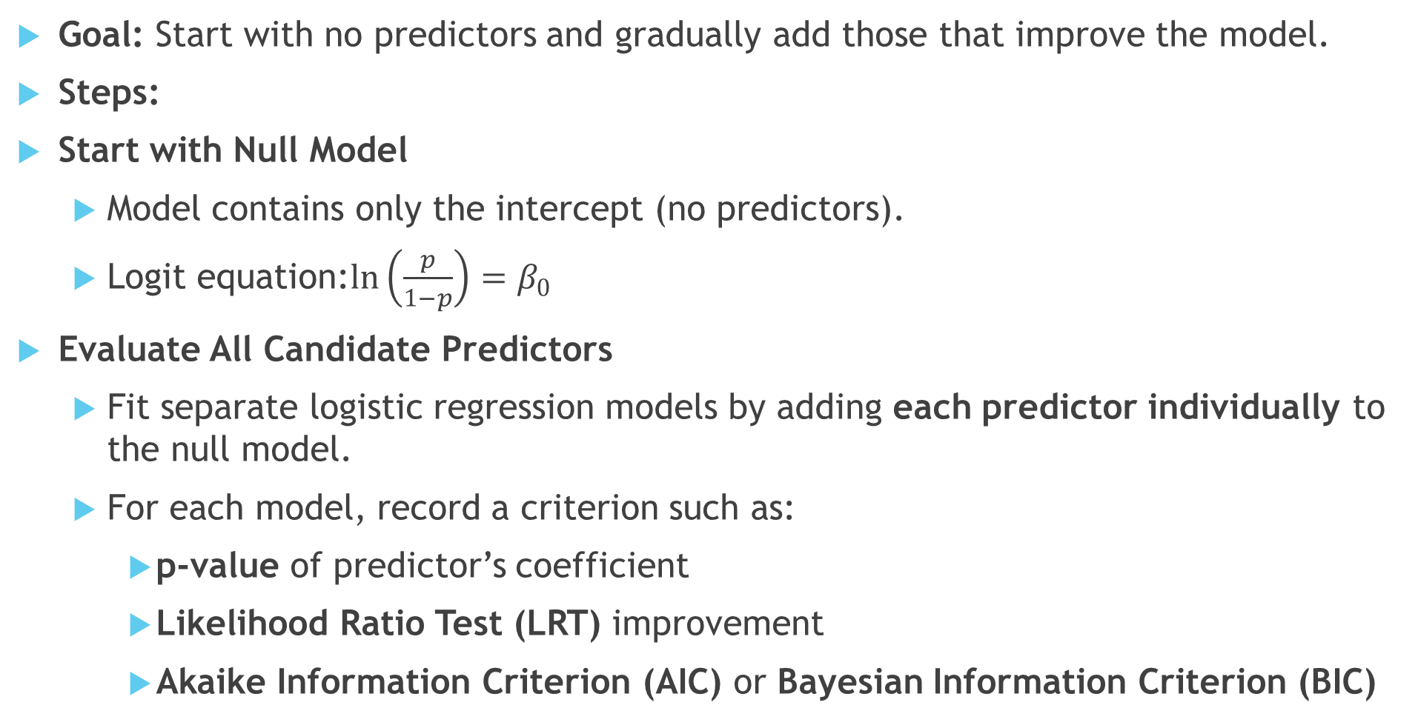
Forward Selection (Step-by-Step)
Goal: Start with no predictors and gradually add those that improve the model.
Steps:
Start with Null Model
  Model contains only the intercept (no predictors).
  Logit equation:$\ln\left(\frac{p}{1−p}\right)=β_{0}$
Evaluate All Candidate Predictors
  Fit separate logistic regression models by adding each predictor individually to the null model.
  For each model, record a criterion such as:
    p-value of predictor’s coefficient
    Likelihood Ratio Test (LRT) improvement
    Akaike Information Criterion (AIC) or Bayesian Information Criterion (BIC)

Slide 5
Forward Selection (Step-by-Step)(contd…)
Select the Best Predictor
  Choose the predictor that gives the most significant improvement (e.g., smallest p-value, lowest AIC).
  Add it to the model.
Add Next Predictor
  Consider all remaining predictors.
  Fit models by adding each of them one at a time to the current model.
  Again, select the predictor that improves the model most.
Repeat Until Stopping Rule Met
  Continue adding predictors step by step.
  Stop when:
    No remaining predictor is statistically significant (e.g., p-value > 0.05), or
    Model selection criterion (AIC/BIC) no longer improves.

Slide 6
2. Backward Selection
Process: Start with all predictors → remove them one at a time.
Steps:
  Begin with a model containing all candidate predictors.
  Remove the least significant predictor (highest p-value above a cutoff, e.g., 0.05).
  Refit the model.
  Repeat until all remaining predictors are statistically significant or meet model selection criteria.
Advantage: Considers joint effects of all predictors from the beginning.
Disadvantage: Can be unstable if the dataset is small or highly correlated.

Slide 7
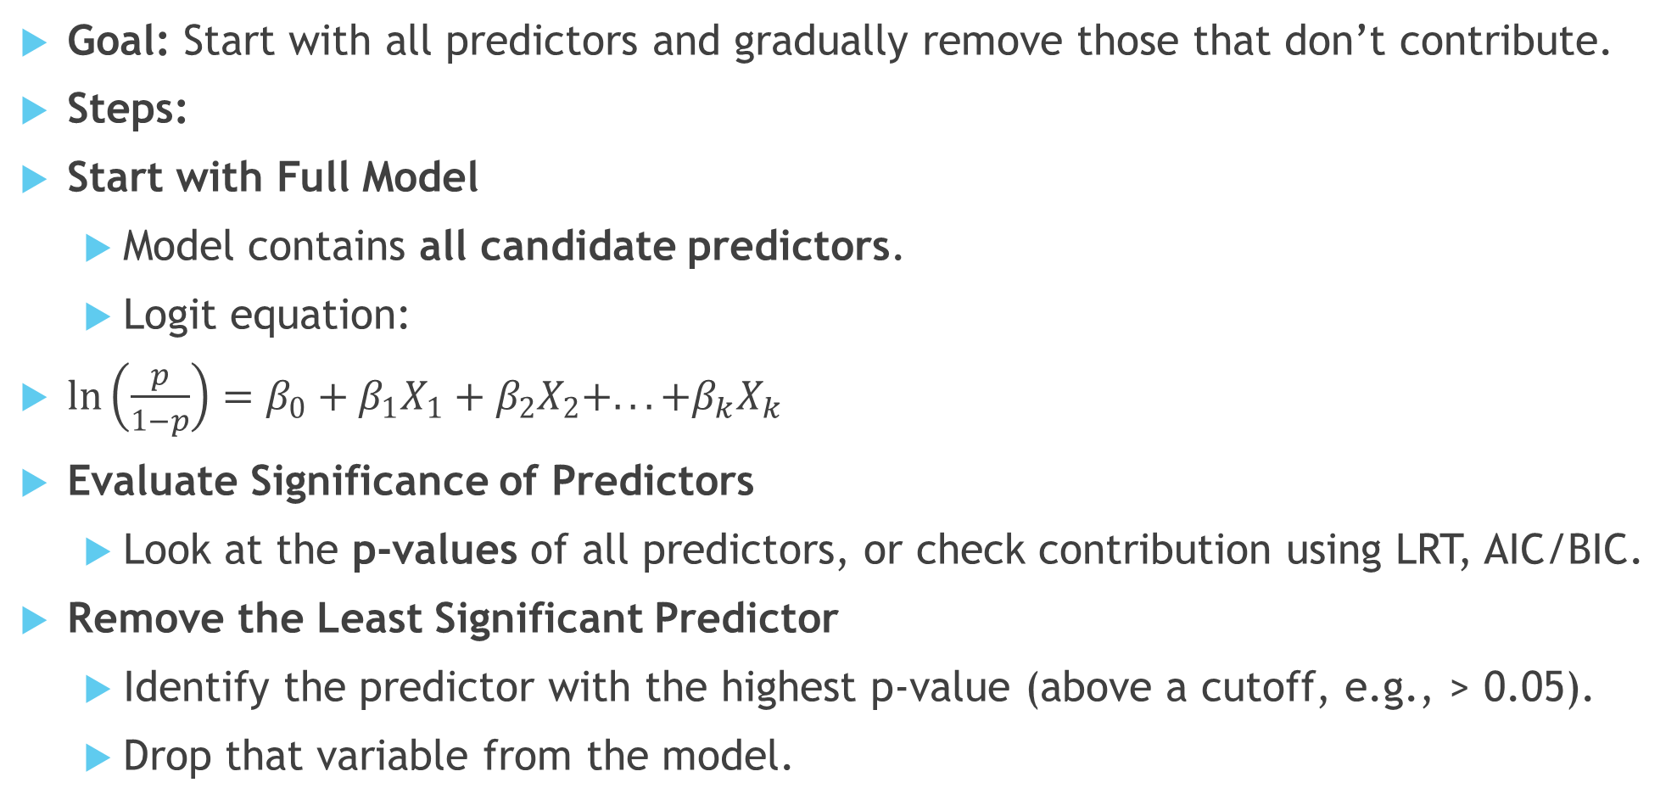
Backward Selection (Step-by-Step)
Goal: Start with all predictors and gradually remove those that don’t contribute.
Steps:
Start with Full Model
  Model contains all candidate predictors.
  Logit equation:
$\ln\left(\frac{p}{1−p}\right)=β_{0}+β_{1}X_{1}+β_{2}X_{2}+...+β_{k}X_{k}$
Evaluate Significance of Predictors
  Look at the p-values of all predictors, or check contribution using LRT, AIC/BIC.
Remove the Least Significant Predictor
  Identify the predictor with the highest p-value (above a cutoff, e.g., > 0.05).
  Drop that variable from the model.

Slide 8
Backward Selection (Step-by-Step)(contd…)
Refit the Model
  Recalculate coefficients with the reduced set of predictors.
Repeat Step 2–4
  Continue removing the least significant predictor one at a time.
  At each stage, check model fit and significance.
Stop When All Predictors are Significant
  Final model contains only predictors that make a statistically meaningful contribution.
  Or stop when removing any more variables worsens AIC/BIC.

Slide 9
Comparison
Aspect | Forward Selection | Backward Selection
Starting Point | Begins with no predictors (null model) | Begins with all candidate predictors (full model)
Process | Adds predictors one at a time | Removes predictors one at a time
Model Building Direction | Bottom-up approach | Top-down approach
Computation | Generally less computationally intensive (especially with large datasets) | More computationally intensive (must fit full model with all predictors first)
Best Use Case | When number of predictors is large and dataset is relatively small | When dataset is large and number of predictors is moderate or small

Slide 10
Aspect | Forward Selection | Backward Selection
Risk of Missing Variables | May miss variables that are only significant when combined with others | Considers joint effects of all variables from the start, so less likely to miss interactions
Collinearity Issues | Less prone to multicollinearity early on, since variables enter gradually | Can suffer more from multicollinearity at the start (with all predictors included)
Overfitting Risk | Lower in the beginning (model starts simple), but can overfit if too many predictors are added | Higher initially (model starts complex), then reduced as non-significant variables are dropped

Slide 11
Aspect | Forward Selection | Backward Selection
Stopping Criterion | Stops when no additional predictor improves the model (p-value, AIC, BIC, LRT, etc.) | Stops when all remaining predictors are statistically significant or improve model criteria
Interpretability During Process | Easier to interpret at early stages (few variables) | Harder to interpret at early stages (all variables included)
Dependence on Significance Threshold | Strongly dependent (a variable not significant alone won’t enter even if useful with others) | More robust, since all variables are considered together before being removed
Computation Time (when many predictors) | Faster, since it avoids fitting models with all variables at once | Slower, especially with high-dimensional data
Preferred When | High-dimensional data, exploratory analysis, need quick/efficient model building | Smaller, cleaner datasets where full model is computationally feasible

Slide 12
Statistical Criteria for Selection
p-value: Predictors are added or removed based on the significance level of their p-values. Common thresholds are 0.05 for inclusion and 0.10 for exclusion.
AIC (Akaike Information Criterion): AIC compares models based on their fit and penalizes for complexity. Lower AIC values indicate a better model.
BIC (Bayesian Information Criterion): Similar to AIC but with a stronger penalty for models with more predictors.
Likelihood Ratio Test: Compares the fit of two models, usually with and without a specific predictor, to determine if the simpler model significantly worsens the fit.

